Slide 1
Gathering Background Information and the Role of Technicians
in Negotiations
Symposium
on the
Settlement of Indian Reserved Water Rights Claims
Funner, CA
August 13, 2019
Doug Oellermann, P.E.

Slide 2
Gathering information
Meaningful settlement negotiations typically cannot proceed without a sufficiently developed technical foundation
Local hydrologic conditions
Water budget
Needs and alternatives
Technical solutions – proposed infrastructure
Ideally, proposed settlement infrastructure should be fully planned, designed, and cost estimated

Slide 3
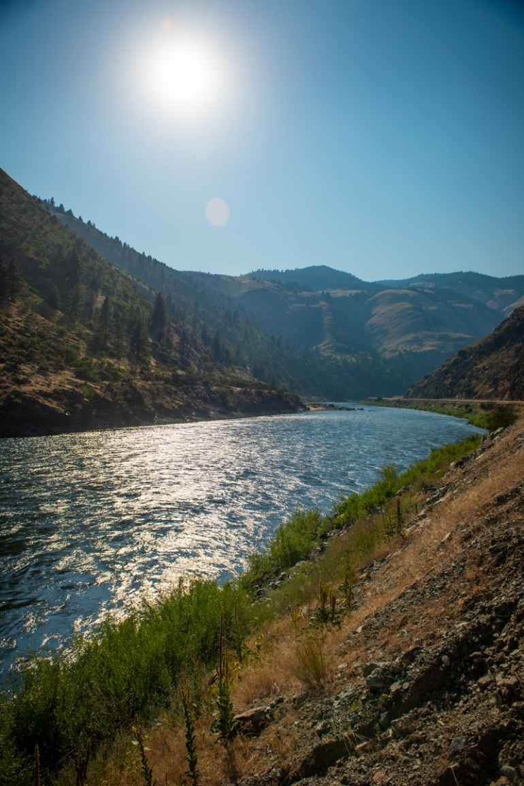
Gathering information
Technical work is expensive and the negotiation parties often lack the resources to conduct all of the needed technical work on their own
Technical work often takes a long time to complete
The completion of one technical study often leads to the start of an additional study

Slide 4
Technical Committee
The parties’ technical experts working together often can achieve common goals, promote efficiencies, and share costs.
Collaborative process
Shared resources and expertise
Creates relationships
Enhances communication
Promotes transparency – data sharing
Ensures that the settlement is technically sound

Slide 5
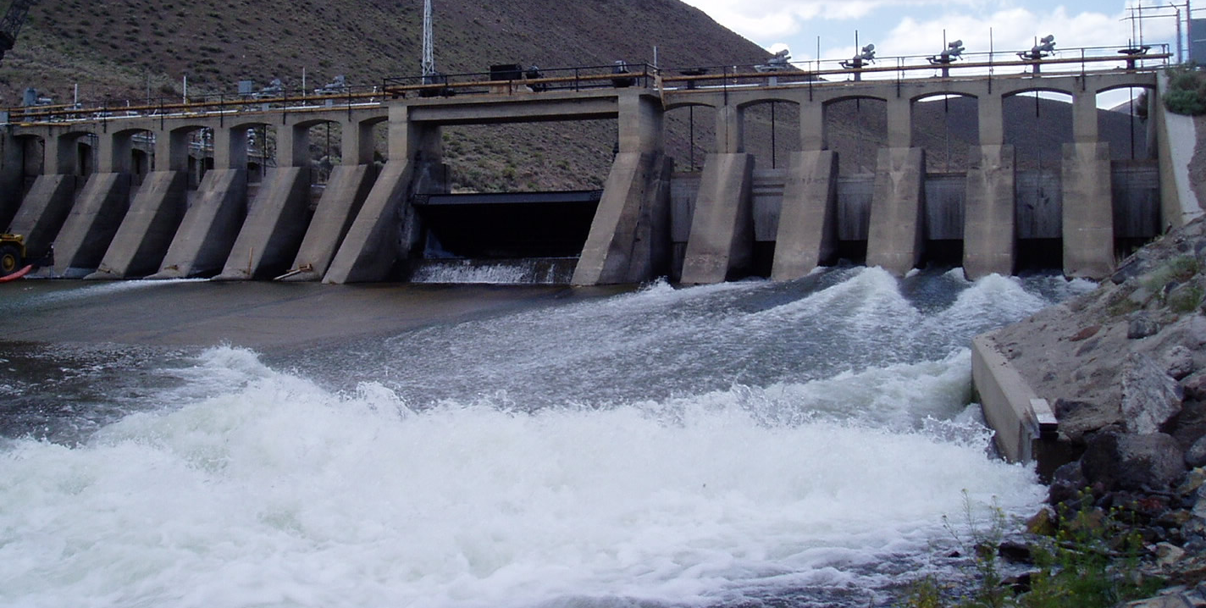
Technical Committee
Leadership and direction of the Technical Committee should be provided by the principal negotiators
Monitor work and provide guidance
Communicate settlement goals and objectives
Provide updates on the current status of the negotiation
Technical Committee – should not set its own direction

Slide 6
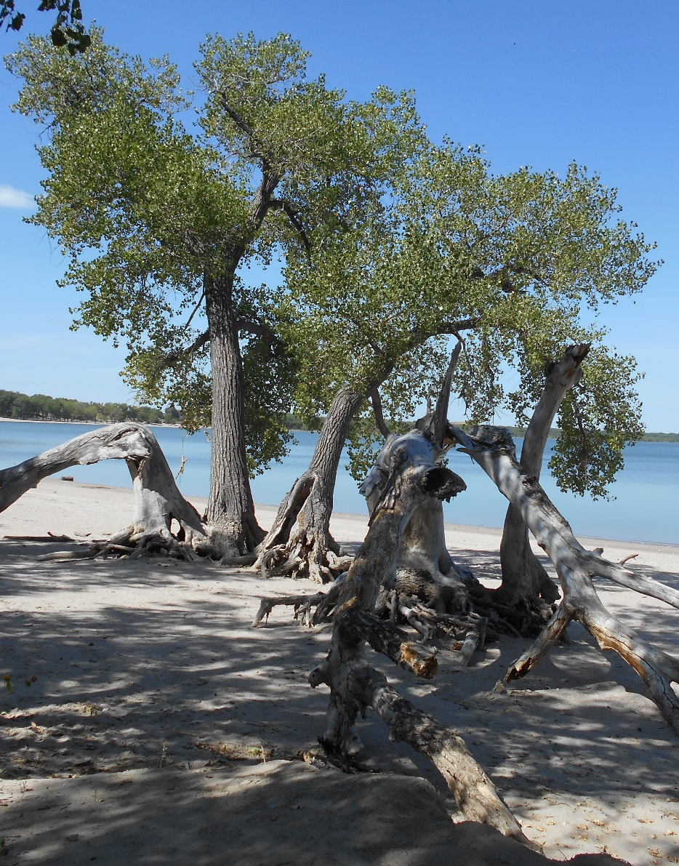
Role of the technical experts: What they should do
Technical experts should be problem solvers
Technical experts should be educators and advisors
Technical experts should communicate frequently with their client and attorneys
Notes:
Technical experts should be problem solvers – propose creative solutions that are applicable to the local setting and needs of the settlement parties
Technical experts should be educators and advisors – explain or translate complex technical information so that it is understood by their client and attorneys
Technical experts should communicate frequently with their client and attorneys – be aware of current issues and the overall shape of the settlement discussions

Slide 7
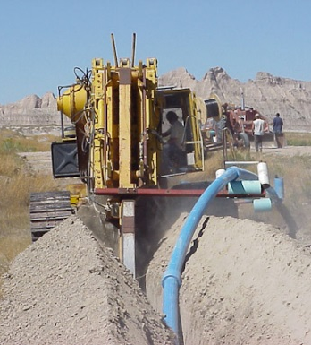
Role of technical experts: What they should not do
Technical experts should not be policy advocates
Technical expects should be aware that they are not the principal negotiators
Technical experts should stick to the facts
Notes:
Technical experts should be problem solvers – propose creative solutions that are applicable to the local setting and needs of the settlement parties
Technical experts should be educators and advisors – explain or translate complex technical information so that it is understood by their client and attorneys
Technical experts should communicate frequently with their client and attorneys – be aware of current issues and the overall shape of the settlement discussions

Slide 8
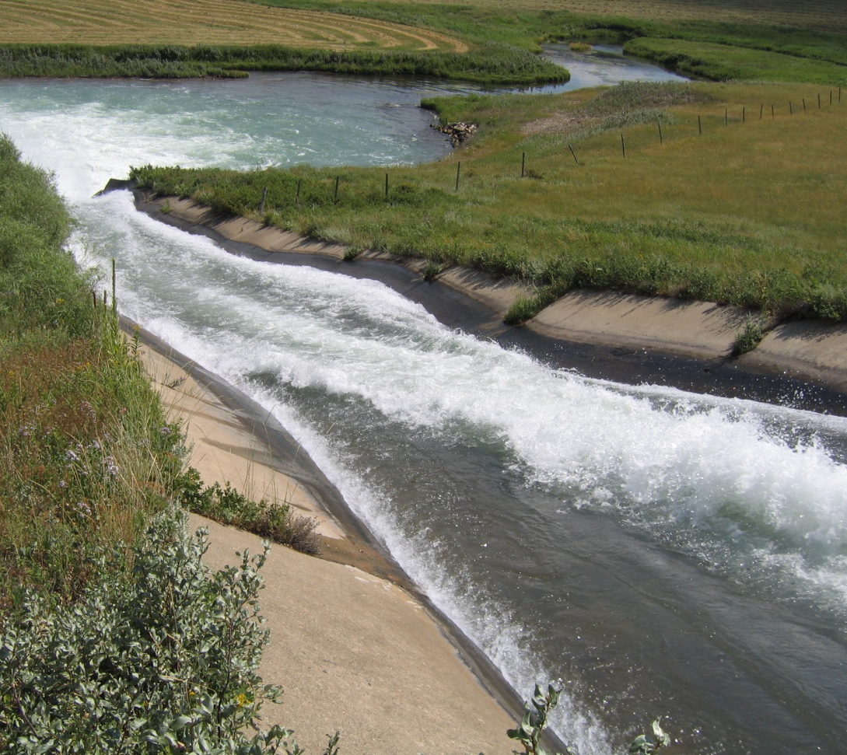
Technical Questions
What is the water supply?
Ground water
Surface water
Existing available storage
What are existing uses?
How are new rights quantified?
Can impact of new rights be mitigated?

Slide 9
Water Supply-Ground Water
If surface water is primary source of the water right, then ground water analysis is minimal
If ground water is primary source of the right, then more studies may be needed
US Geological Survey and state water agencies are sources of data, while USGS may be best choice for further studies
Ground water studies can take several years, so starting early in negotiations is essential

Slide 10
Water Supply-Surface Water
Surface water model is frequently required
Joint model is highly preferable
Model development is a negotiation
Multiple data inputs, many subject to technical judgment
Data examples--irrigated lands, cropping pattern, consumptive use, efficiencies, return flows, etc
Once base model is calibrated, then start to run scenarios to evaluate various levels of use and impacts

Slide 11
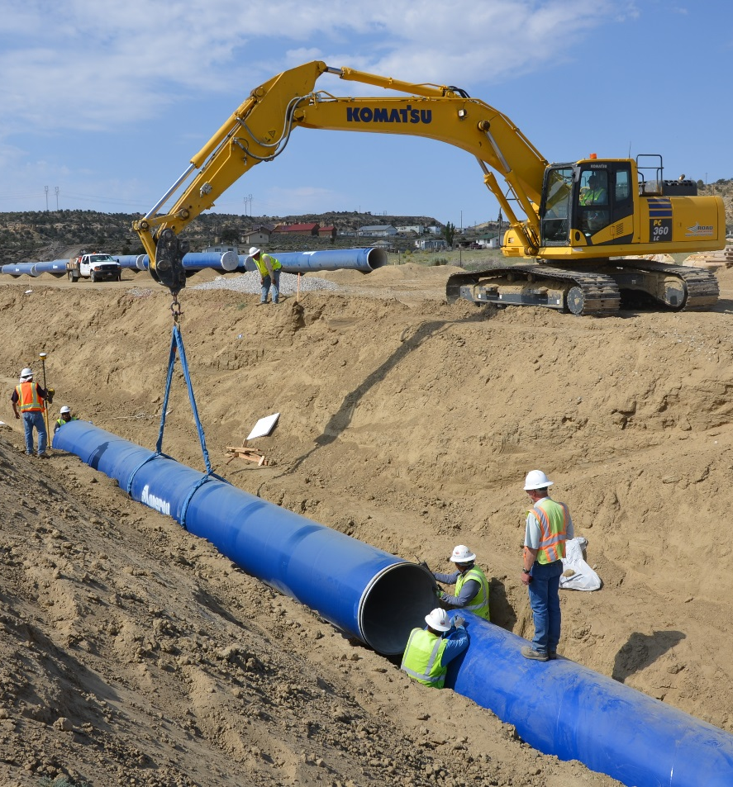
Water Supply-Storage
Reclamation or other entities may have unallocated storage in the basin
Unallocated storage to supplement natural flows to satisfy new rights is a potential source of water
The surface water model can evaluate the use of this unallocated storage in a settlement

Slide 12
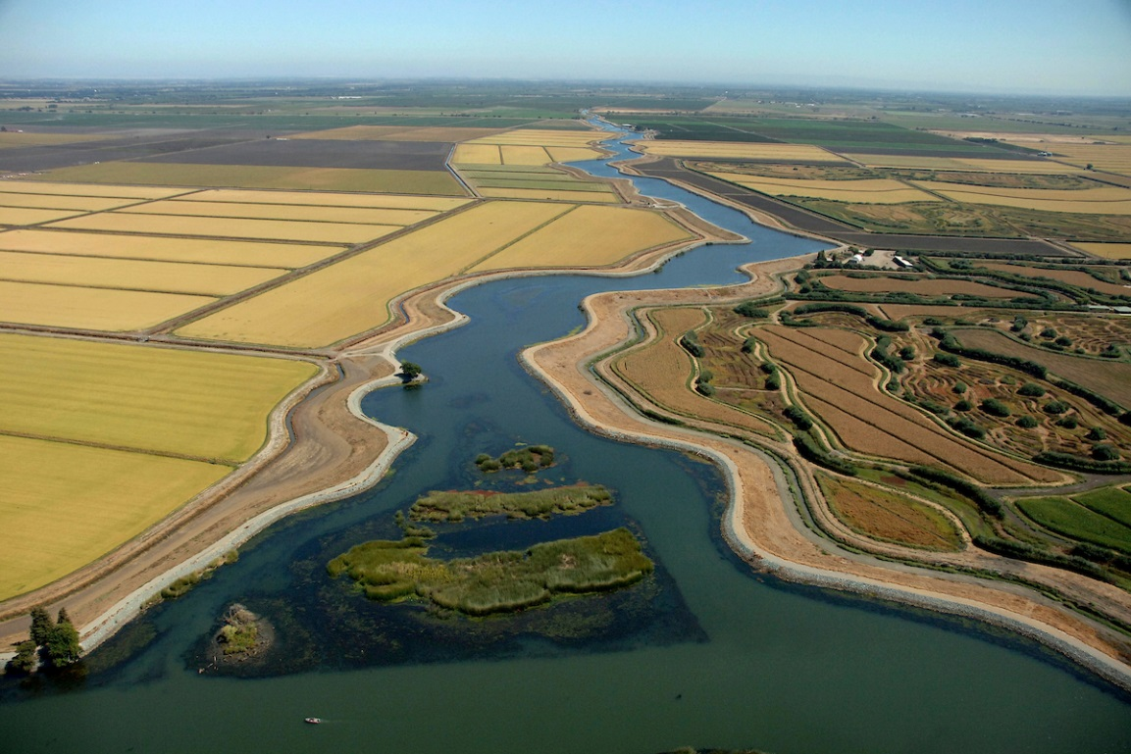
Existing Uses
Irrigation-identified through aerial photos, water rights data, state inventories, irrigation company records, satellite imagery
Domestic, Commercial, Municipal & Industrial (DCMI)-identified through water company records, estimates based on typical uses
Stock-based on number of stock wells, ponds, or animal units
Other-recreation, fish, etc. as negotiated

Slide 13
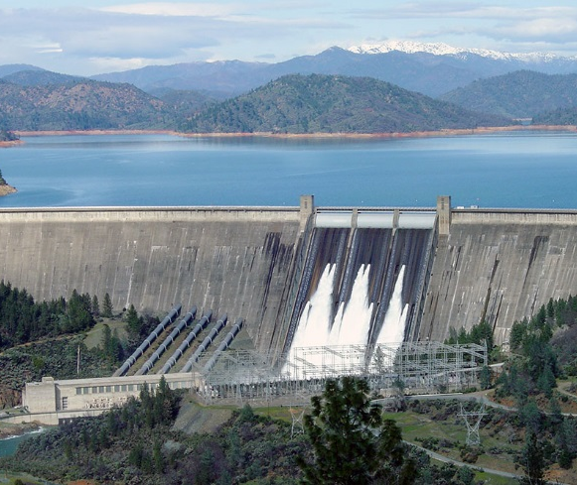
New Water Rights
New irrigation-based on project using Natural Resources Conservation Service soil surveys, land classification, water availability, cropping pattern, consumptive use, efficiencies, etc.
DCMI-based on current populations, projected out through a planning horizon, at an accepted per capita use rate
Stock-based on maximum buildout and utilization of range resources
Other-recreation, fish, etc-as negotiated

Slide 14
Mitigation of Impacts of New Rights
New rights may have impact on existing state-based rights
The goal of state negotiators is to have no impact on existing rights
Mitigation measures are identified and can be evaluated using model
Mitigation might include:
Use of unallocated storage in existing reservoir
Construction of new storage
Reclaiming return flows that leave the basin
Improving efficiencies
Other

Slide 15
Technical Committee Recommendations
Technical committee recommendations are result of negotiated data analysis
Committee makes recommendations to the negotiation parties
Negotiation parties take technical recommendations into account along with other factors
Negotiation parties shape and define the settlement agreement

Slide 16
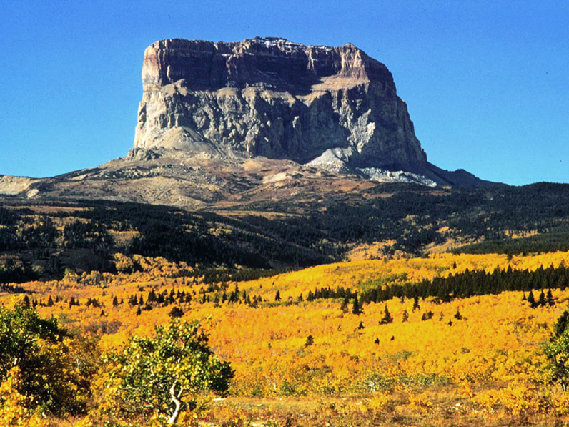
Contact Information
Doug Oellermann, P.E.
Blackfeet Settlement Project Manager
(406) 247-7712
doellermann@usbr.gov

