Slide 1
Indian Water Rights and Associated Interests
Professor Robert T. Anderson
University of Washington School of Law
Seattle, WA
July 2017

Slide 2
Overview
Indian water rights rooted in federal law, including aboriginal title as recognized in U.S.
Deep conflicts between Indian and non-Indian rights
Indian treaties, agreements, statutes and Executive Orders at foundation of tribal water rights
Expensive and lengthy litigation; settlements

Slide 3
Common Law Roots to Codes
Mining camp rules for mining claims applied to water used in those camps under territorial and state law
Chaotic in terms of record keeping and notice to others
Wyoming adopts first water code in 1890; Alaska in 1966

Slide 4
State Water Law – Western States
Water allocated according to “prior appropriation”
Water availability determination (theoretical)
First in time is first in right
Beneficial use
Productive purpose
Use it or lose it
Reasonable efficiency
Public interest
Little enforcement

Slide 5
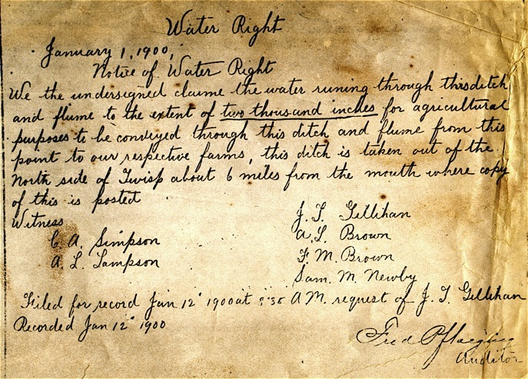

Slide 6
Water to Fulfill Indian Treaties
Indian reserved water rights are based on federal law
Winters doctrine: associated with establishment of Indian reservations for agricultural purposes
Aboriginal water claims for instream flows, sometimes called Winans rights
Spanish law (to 1821) or Mexican law (to 1846) (Pueblos)

Slide 7
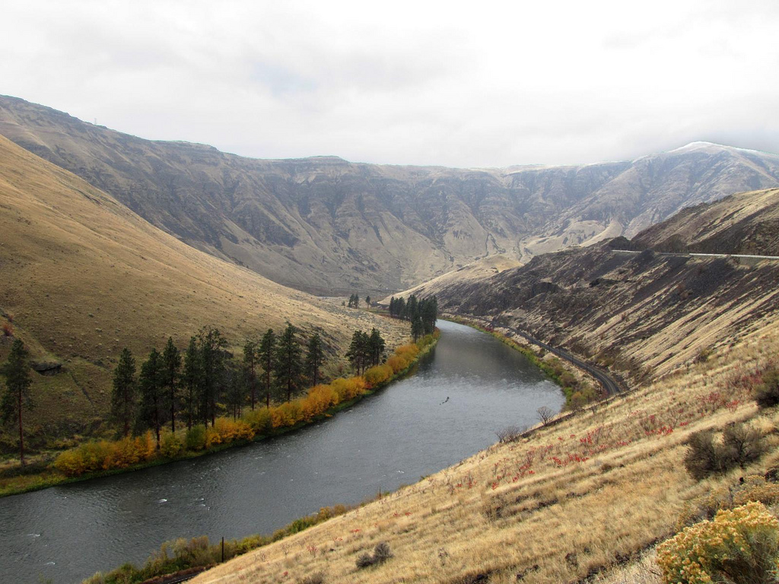
United States v. Winans (1905)

Slide 8
Winans -- Rules
Implied easement to cross non-Indian land to reach usual and accustomed stations
State may not defeat right by authorizing non-Indian fishing with wheel
Creation of State has no effect on federal rights reserved by treaty

Slide 9
Winters v. United States (1908)
Indian reservation in 1888 established for agricultural purposes
State appropriators precede Indian use, but after 1888
Court implies reserved Indian rights as of the date of the reservation – 1888 --- to fulfill agricultural purposes of the reservation
Notes:
P. 707 of book.
Review highlighted language on 708-709
3. Agricultural purpose of reservation easy to ascertain -- nearly all treaties and Indian Affairs Commissioners Reports from earlier.

Slide 10
Winters v. U.S.: Non-Indian water use for irrigation precedes Indian use
Non-Indians
Milk River
Fort
Belknap
Res.

Slide 11
Post-Winters Developments
Open-ended court decrees (lack of certainty)
Allotment water rights and transferability recognized (U.S. v. Powers 1939)
Extensive non-Indian development through BOR; Tribal rights ignored
U.S. has very poor record in developing and protecting Indian water up until the 1970s
Notes:
See p. 712 for open-ended decrees
Powers and allotments covered later at 755
Note 1 on p. 716-17 for poor record

Slide 12
Arizona v. California (1963)
Water rights litigation over agricultural reservations along Colorado River
Sufficient water reserved to meet present and future needs of the reservation
Practicably irrigable acreage (PIA) is the measure for land not historically irrigated
Notes:
Case begins on p.713; Congress divided up the Colorado River among the states

Slide 13
Arizona v. California (1963) – Colorado River Indian & Federal Reservations
Nevada
Lake Mead Nat’l Rec. Area
Fort Mojave
Indian Res.
Lake Havasu Nat’l
Wildlife Refuge
Chemehuevi
Indian Res.
California
Colorado River
Indian Reservation
Arizona
Imperial & Cibola
Nat’l Wildlife Refuges
Fort Yuma (Quechan)
Indian Reservation
Cocopah Indian
Reservation
Mexico
Notes:
Court rejects equitable apportionment
Court rejects arguments that E.O. could not reserve water; and could not reserve water at all after statehood, p. 715
Agricultural purposes clear.
PIA is the measure – not “reasonably forseeable needs.”
Arizona II on p. 717 refuse to reopen, casts some doubt on PIA as too generous.

Slide 14
Litigation Increase in the 1970s
National Water Commission Report (1973) (bi-partisan report chastises federal record; urges litigation to protect tribal water rights)
McCarran Amendment authorizes state court jurisdiction of federal and Indian rights, 43 U.S.C. § 666
Ariz. v. San Carlos Apache Tribe (tribal rights subject to adjudication in state courts)
Notes:
This will be the main place to discuss the McCarran Amendment. It was contentious and took a while, but the result is simple. States may adjudicate Indian water rights.

Slide 15
Instream Flow Protection
Confederated Tribes of the Colville Reservation v. Walton, 647 F.2d 42 (9th Cir. 1981) (instream flows to support replacement fishery; salmon fishery destroyed by Grand Coulee Dam)
United States v. Adair, 723 F.2d 1394 (9th Cir. 1983) (right to maintain stream flows to a protected level; Klamath rights survived termination)
Department of Ecology v. Yakima Res. Irr. Dist., 850 P.2d 1306 (Wash. 1993) (on and off reservation claims)
United States v. Anderson, 591 F.Supp.1 (E.D. Wash. 1982) (water temperature; still in litigation in 2015)
Notes:
1. Klamath reservation established for dual purposes; follows narrower federal reservation standards, but dual purposes, p. 720-21.
Look at note 13 on p. 721 – Judge Canby.

Slide 16
Litigation
Litigation generally follows PIA measure, but tribes and U.S. advance other theories – homeland and instream flows;
Big Horn decision affirms large PIA award, pfor narrow interpretation of purposes of reservation
Compare Gila River -- AZ S.Ct. multi factor homeland test (”minimum need” from federal reserved cases)
Notes:
1. Big Horn on p. 723; Gila River on p. 730

Slide 17
Quantification
Agricultural purposes:
water right awarded for current and historically irrigated land
Future lands are provided water if meet the PIA test
Big Horn decision affirms large PIA award in 4-4 decision

Slide 18
Litigation
State courts and federal courts adopt various interpretations of Indian rights; Groundwater claims largely successful, See Agua Caliente (9th Cir. 2017)
Strong foundation in Winters and Winans
Little U.S. Supreme Court Guidance
Great uncertainty in the details

Slide 19
Allotment Water Rights
U.S. v. Powers (1939) (non-Indian right to use waters of Indian allottees)
Colville Tribes v. Walton (1985) (non-Indian gets water on pro-rata share of irrigable acres as upper limit – based on actual Indian use and “reasonable diligence” here, 30 acres regularly irrigated over 23-27 year period; attempt to increase to 104 acres fails)

Slide 20
Settlements
Congressional approval usually required: 1. appropriations authorized; and 2. tribal rights are trust property
32 settlements approved by Congress; 3-4 others without such approval
Litigation marches on slowly

Slide 21
Indian Water Settlements
Criteria and Procedures on p. 765-66; OMB Directive (June 2016)
Thirty-two Indian water settlements since 1978;
Three most recent: Pub. L. No. 114-322 (2016) Pechanga Band of Luiseno Mission Indians; Choctaw Nation and Chickasaw Nation; Blackfeet Tribe.

Slide 22
Regulatory Authority
Walton v. Confederated Tribes of the Colville Reservation (9th Cir. 1981) (no state regulation of non-Indian on fee lands on No Name Creek – non-navigable creek entirely within reservation)
U.S. v. Anderson (9th Cir. 1984) (state may regulate non-Indian water use within reservation when navigable river is only partially within reservation)

Slide 23
Tribal Power to Regulate
Water use on reservations
Water quality on and off reservations
Not much litigation or effort; why not?
See Robert T. Anderson, Water Rights, Water Quality and Regulatory Jurisdiction, 34 Stan. Envtl. L. J. 101 (2015)

Slide 24
Treaty-Based Habitat Protection
U.S. v. Washington (1979) (Stevens Treaties provide for 50% tribal share of fish passing usual an accustomed stations
Continued impact of Winans; protect treaty share from state and private interference
Protection of environment for treaty fisheries

Slide 25
Culvert Litigation
Phase II of U.S. v. Washington litigation; early 1980s; 9th circuit vacates lower court decisions on summary judgment to wait for actual controversy
Late 1990s; studies reveal state constructed and owned culverts blocking large numbers of salmon
Tribes and United States sue Washington to mandate repairs

Slide 26
U.S. v. Washington (9th Cir. 2016)
“we conclude that in building and maintaining barrier culverts Washington has violated, and continues to violate, its obligation to the Tribes under the fishing clause of the Treaties.”
Mandatory injunction issues to compel repair United States v. Washington, 827 F.3d 836
(9th Cir. 2016)

Slide 27
Clean Water Act
Cooperative federalism approach provides for “treatment as a state”; Environment Protection Agency (EPA) Role
“Since 1991, EPA has followed a cautious interpretation that has required tribes, as a condition of receiving TAS regulatory authority under section 518, to demonstrate inherent authority to regulate waters and activities on their reservations under principles of federal Indian common law.”
Notes:
1. Comments closed on October 6, 2015 for proposed rule to drop the inherent authority test in favor of delegation theory.

Slide 28
New Interpretive Rule by EPA
“[EPA]concludes definitively that section 518 includes an express delegation of authority by Congress to Indian tribes to administer regulatory programs over their entire reservations, subject to the eligibility requirements in section 518. This reinterpretation streamlines the process for applying for TAS, eliminating the need for applicant tribes to demonstrate inherent authority to regulate under the Act and allowing eligible tribes to implement the congressional delegation of authority.” Revised Interpretation of Clean Water Act Tribal Provision, 81 Fed. Reg. 30183-01 (2016).

Slide 29
CWA
If certified by EPA, tribes may set water quality standards more stringent than minimum federal standards
May affect upstream discharges by blocking discharge permits that would result in violation of water quality standards on reservation, City of Albuquerque v. Browner
Tribes may also issue NPDES (point source) permits, but no tribe in the United States has sought to do so under the CWA

Slide 30
The End
Thank you.

